Slide 1


Malware Analysis Tools and Techniques
Basic Dynamic Analysis
Last Update: 24/10/22

Slide 2
Lesson Objectives
Running the Malware
Process Monitoring
File Monitoring
Registry Monitoring
Network Monitoring

Slide 3
Dynamic Analysis
Dynamic analysis is any examination performed after executing the malware is executed.
Dynamic analysis is usually performed after static analysis has reached a dead end.
Dynamic analysis allows you to observe the malware’s true functionality
Dynamic analysis can put your system or network at risk. Good to use sandboxes / virtual machines

Slide 4
RUNNING THE MALWARE

Slide 5
Sandboxes
There are many popular sandboxes that automatically analyse malware and produce a report
Examples are: GFI Sandbox, Anubis, Joe Sandbox, ThreatExpert, BitBlaze etc.
Provides an easy-to-understand output and are great for initial triage.
All sandboxes are similar in approach. For this module, we will take GFI Sandbox (formerly CWSandbox)as an example.

Slide 6
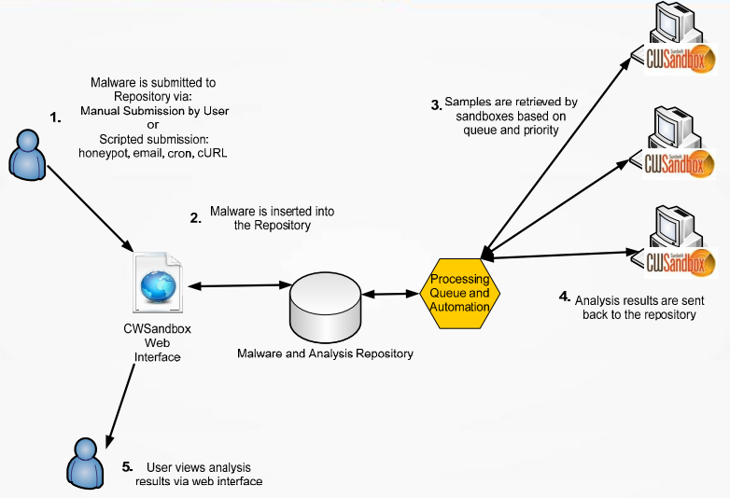
GFI Sandbox Overview

Slide 7
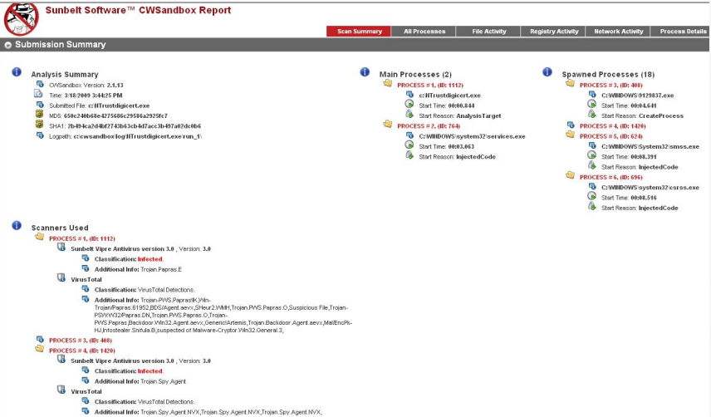
GFI Sandbox Report Sample
Processes
File Activity
Registry Activity
Network Activity

Slide 8
GFI Sandbox Report Sample
Analysis Summary provides basic static analysis information and high-level dynamic analysis results
File Activity provides lists of files that has been opened / read / created / deleted
Mutexes created by the malware
Registry Activity lists the changes to the registry
Network Activity includes network activity spawned by malware (listening to ports / DNS requests)
Notes:
A mutex is a program object that allows multiple program threads to share the same resource, such as file access, but not simultaneously. When a program is started, a mutex is created with a unique name.

Slide 9
Sandbox Drawbacks
Command line options
Waiting for some command-and-control instructions
Not all events may be recorded because the Sandbox did not wait long enough
Malware may detect that it is running in a Sandbox
Conditions are not met for Malware to run properly
Sandbox OS may not be correct for the malware to run properly.

Slide 10

Running the Malware
For the purpose of this module, ALWAYS run the malware within a VM.
Take a snapshot of the VM before the malware is executed.
Usually Malware comes in two forms: EXE or DLL
To run a DLL

Slide 11



Running the malware
Export arguments must be a function name or ordinal selected form the exported function table
DLL often runs most of their codes in their DLLMain Function
If the DLL needs to install a service, you can use the following commands:

Slide 12
Process Monitoring

Slide 13
Process Monitor (procmon)
Combines the functionalities of two legacy tools: filemon and regmon
Monitors
Registry activity
File activity
Process activity
Network activity (though there are better tools for that)
Procmon monitors all system calls for all processes by default. (sometimes up to 50,000 calls per min)
There is a need to filter events
Notes:
http://technet.microsoft.com/en-us/sysinternals/bb896645.aspx

Slide 14
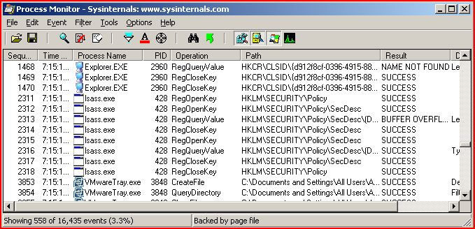
Procmon

Slide 15
Filtering in ProcMon: Readymade filters
Notes:
Ready Made filers for registry activity, file system activity, Process activity, Network activity

Slide 16
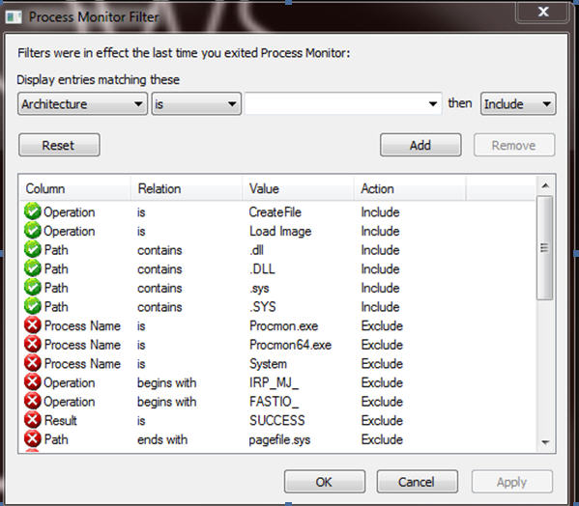
Filtering in Procmon

Slide 17
Process Explorer
Provides insight to running processes
Features
List active processes
DLLs loaded for each process
Process properties
Active TCP connections
Create / kill / validate processes

Slide 18
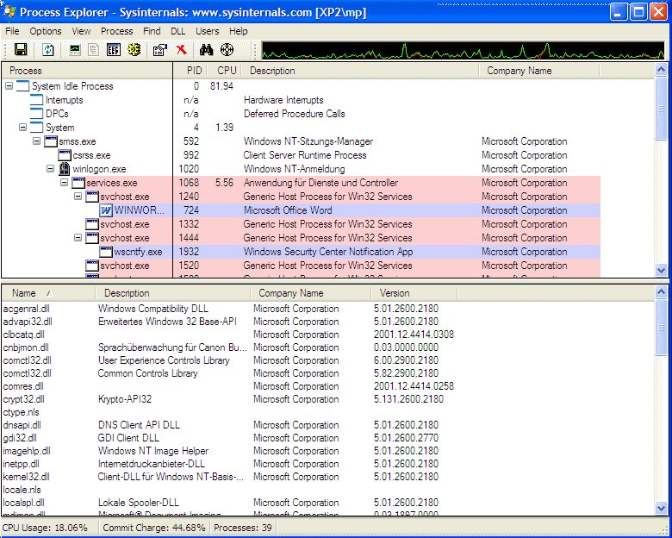
Process Explorer

Slide 19
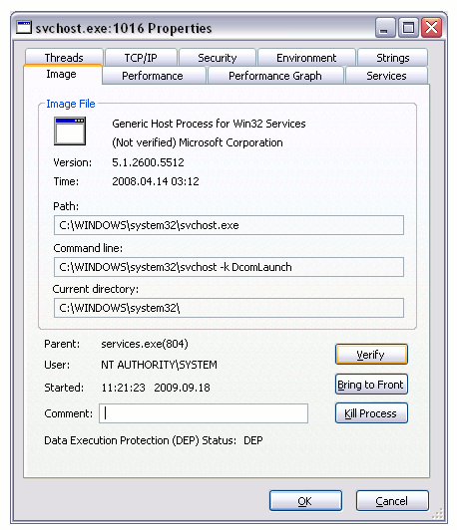
Verify Option
Lots of malware has the same name as legitimate Windows Processes
Verify option allows you to verify whether a process has been digitally signed by Microsoft
Only applies to process on disk and not in RAM.

Slide 20
Monitoring Registry
Regshot is an opensource registry comparison tool
Compares two registry snapshots and reports on the difference
Take 1st Shot
Run Malware
Take 2nd Shot
Compare

Slide 21
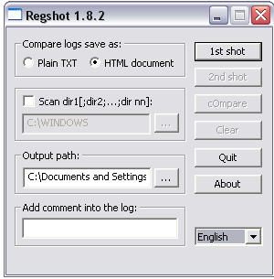
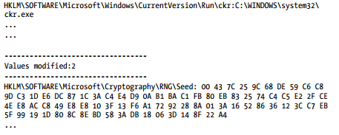
Regshot

Slide 22
CaptureBAT
Behavioural analysis tool for WIN32 applications
Monitors the state of a system during the execution of the applications and processing of documents
Monitoring is performed at a low kernel level.
Very good tool to exclude event noise that naturally occur in a system
Notes:
http://www.honeynet.org/node/315

Slide 23
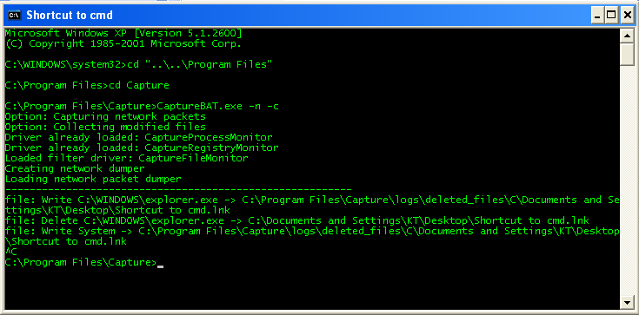
CaptureBAT

Slide 24
Monitoring Network Activity

Slide 25
Faking a Network
Malware often sends out information to another server
Malware sometimes tries to connect to a command-and-control server to await for instructions
We need to fake a network so that the malware does not know that it is in a virtualised environment
In this way, we can reveal most, if not all, functionalities of the malware

Slide 26
ApateDNS
Free tool from Mandiant
Able to:
List DNS requests made by malware
Spoofs DNS responses
NXDomain
Notes:
http://www.mandiant.com/resources/download/research-tool-mandiant-apatedns

Slide 27
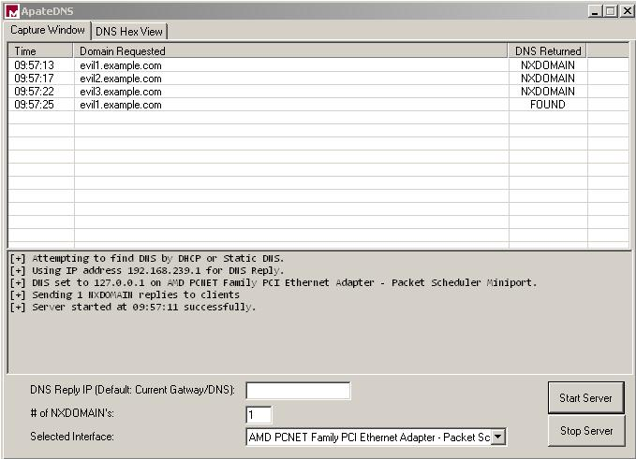
ApdateDNS
5
1
4
2
3

Slide 28
Netcat
Netcat is also known as the TCP-IP Swiss Army Knife
Can be used for inbound/outbound connections
Port scanning
Tunneling
Proxying
Port forwarding and more…

Slide 29
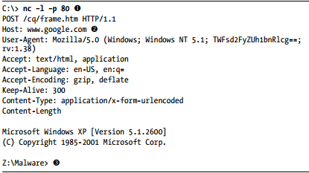
Using netcat
Use nc to analyse Rshell
1
2
3

Slide 30
Wireshark
Opensource network sniffer that captures network packet
Wireshark provides
Visualisation of network packets
packet-stream analysis
In-depth packet analysis

Slide 31
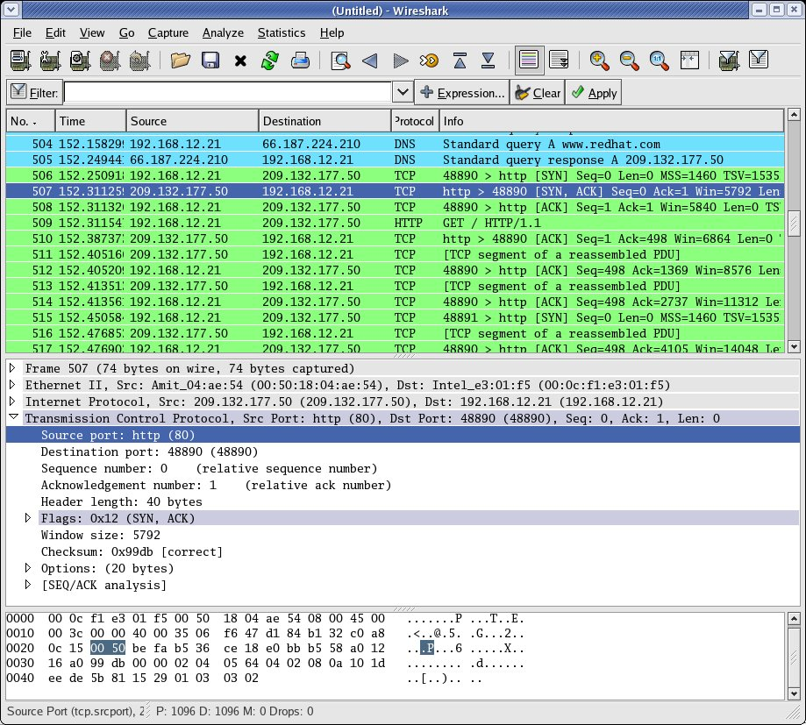
Wireshark
1
2
3
4

Slide 32
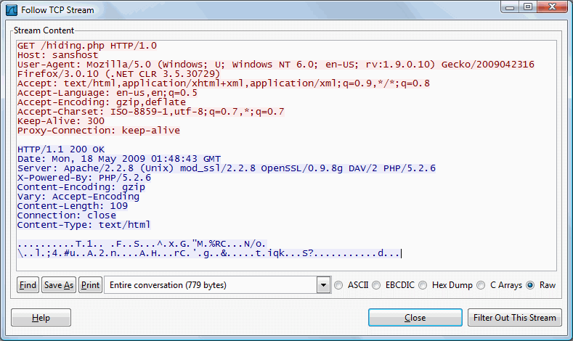
Wireshark – Follow TCP Stream

Slide 33
Tutorial
How do you run a malware in the form of DLL?
Which tool would you use to monitor Registry?
What is the difference in purpose between Procmon & Process Explorer?
Which tool would you use to capture network packets?
What is mutex? Why is it important in the context of malware analysis?
What is the purpose of Windows Registry?
What is the difference between a process and a thread?
What is the difference between an Application, Process, and Services?

